Slide 1
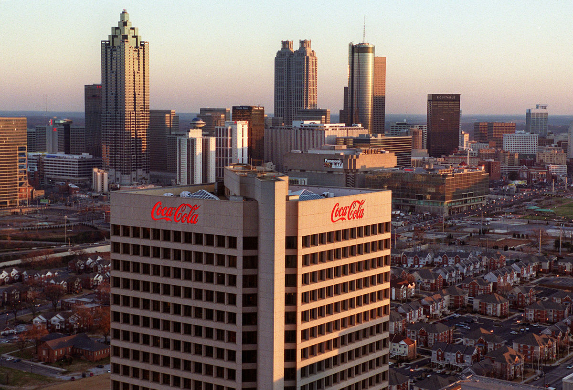


A New Age of Problem Solving
Using Agent Based Modeling to Understand Consumer Behavior
September 2019

Slide 2
AGENDA
Agent Based Modeling
Introduction
Applications
Fuze Tea Prototype
Executive Summary
Approach
Sample Output & Insights
Simulator Demo
Discussion

Slide 3
Market Forces| Consumers are constantly affected by different interacting stimuli within an ever more complex environment
Evoked Set
Historical Behavior
Drinking Moments
Economic Conditions
Product Pricing
Competitor Products
Product Availability
Competitor Marketing
External
Factors
Consumer
Coke
Factors
Marketing Channels
Competitor Pricing
Marketing Message
Temperature
Consumer
Factors
Marketing Frequency
Demographics
Product Options
Social Index

Slide 4

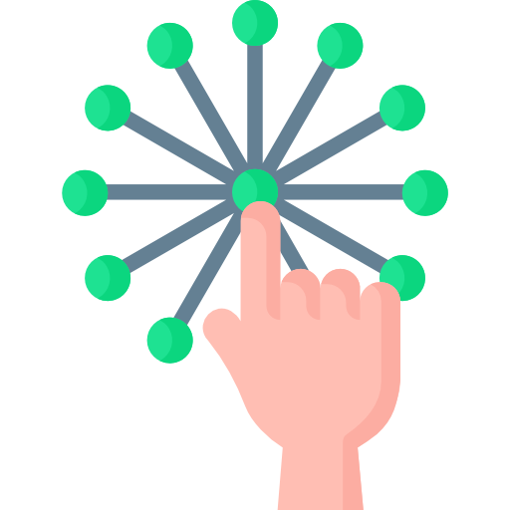

Consumer Behavior| Agent Based Modeling provides a bottom up approach to model consumer behavior and their purchase decision process incorporating all stimuli
Environment
The environmental factors and their impact on consumer behavior is also integrated
Intervals
Behavior of the consumers are simulated over a set duration of time
3
4
Rules
The brain of the agent is the predefined rules or predefined purchase decision process
Validation of Interactions
The consumer behavior is influenced by feedback loops and interactions with other agents and validating using real world data
2
5
Agents
Each agent is a US consumer with unique demographics
Simulation
Simulate the future and continuously improves over time utilizing ML algorithms
1
6
Outcomes
Key Differentiators
Consumer Insights
Data Infusion
Learning Model
Under consumer decision journey providing new actionable insights
Disparate data sources integrated in one decision making environment
Incorporate feedback back to the model quickly
Data Triangulation
Interdependencies
& Interactions
Alternative Data Source
Forward Looking & Portable
Creates synthetic data at the consumer level
Ability to breakdown multiple data sources and validate with similar data from other sources
Understand the cumulative impact of factors over a period of time through ML
Generates forward looking & portable analysis and insights
Notes:
The proposed solution is to understand the market dynamics using a bottom up approach with consumer at its center.
What ABM as a technique does is enables us to create individual consumers as entities in a virtual world and then create a network of all the factors which impact his decision making.
These factors could be from his profile or the market forces like we talked about earlier.
We then leverage Bayesian networks to model the interactions of all these factors. The combined impact of all these factors is then quantified for each consumer by fusing all the available data to us. All data sources are integrated and enhanced whether it is national survey of consumer preferences , CTA level Nielsen data ; store level feature vision data or publicly available census data… The Bayesian network allows creation of business intuition based heuristic rules and probability assumptions which breaks down data till the consumer level.
We then fine tune and validate these heuristic rules and probability assumptions by modeling past behavior of all agents and comparing the aggregated results with the past actuals data.
Once we have a set of rules and assumptions which in aggregate is comparable with the past we can say that we have better understanding of consumers.

Slide 5


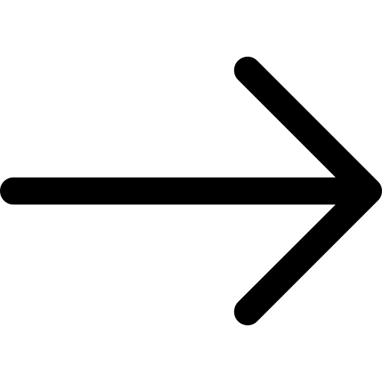




Why ABM?| Compared to traditional models, ABM delivers an all encompassing decision making engine
ADVANCED PREDICTIVE MODELING
SIMULATION BASED EMERGENCE
Relies entirely on historical data
With products and market expectations/reactions constantly changing, predicting demand of new products becomes challenging if only historical demand patterns are considered
Future insights through predictive simulation
Customers, their purchase patterns, upgrade cycle, market reception to competitor products, promotions etc. can be simulated to arrive at a more robust forecast
Models linear cause-effect relationships
With the real world being a complex interactions between various entities, conventional models consider effects of various factors individually
Feedback from real world can be incorporated
Real time inputs like customer reception to your products and competitors, response to promotions, resonant sentiments on message boards, blogs etc. can be used to model for demand
Only key demand shaping factors could be considered
The results from traditional models are modelled based on the data and doesn’t capture intricate effects at a customer level
Exhaustive set of demand parameters are considered for modelling
Simulation based predictions not only capture overall behavior of the system, but they also give insight into the most granular demand influencers and the interactions among them
Rigorous predictive analysis must be applied rather than limiting our approach to unfocused, historical data mining that merely identifies interesting correlations.
Notes:
So let’s talk about why ABM really separates itself from the traditional methods we see in analytics today. Your current models are for the most part linear models that establish correlation. This is done primarily utilizing historical data and in today’s constantly evolving marketplace it can be difficult to really use historical data to sort of model unexpected futures. Most models are top down trying to solve one broad problem say sales or attrition using few key factors available in the data. ABM attempts to fill in these holes. Through a bottom up approach – from the customer up. We attempt to understand or model how our customers behave - we simulate the future and gather predictive insights. We try to model the intricate factors and interactions at a very granular level to truly understand the overall system behavior. We are then able to incorporate real time information instantly – not only to improve the overall model but to also simulate the future based on this new information.
ABM incorporates all available data and pockets of analysis into one decision making engine.

Slide 6
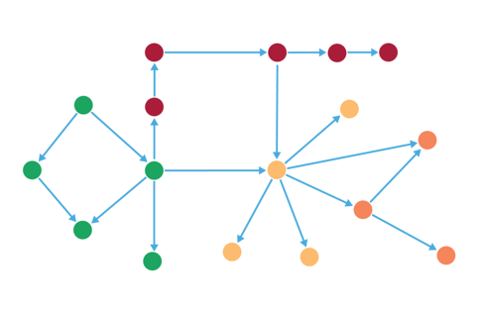
The Brain| Bayesian Networks provide a intuitive framework that models the consumer purchase decision through a series of conditional probabilities
A Consumer’s Path to Purchase consists of some sequential steps:
Need Recognition
Information Search
Alternative Evaluation
Purchase
Post Purchase Experience
Decision taken at every step depends on the outcome of previous step
Every decision can be calculated as a probability distribution, conditioned on some prior variables
Bayesian Networks
Bayesian Networks
Two components:
Node
Arc
Key Properties
Probabilistic graphical model that represents a set of variables and their conditional dependencies via directed acyclic graph
Graph structure and parameters make the model – no formulas, no equations
Compact representation of Joint Probability Distribution
Establishes causality, not just correlation
Omni Directional Inference
Notes:
Brain – Most important part of ABM
They can be very simple or very sophisticated.
We at Mu Sigma felt Bayesian Networks were the perfect fit as it is able to model the decision process through conditional probabilities.
Over the years, behavior science has brought us numerous types of buyer decision models and we established a common one which you see on the screen.
The Bayesian network allows us intuitively create this framework. We are able to incorporate these factors together. Merge high level intuition with intricate details coming out of data.

Slide 7




Application| Developing a Consumer Behavior laboratory can provide Coke the ability to check market strategy robustness and test different causation factors within the marketplace
With continuous enhancements ABM can support a wide range of business units:
Consumer Check
Develop consumer level insights into market levers and factors that affect the purchase decision
Marketing Team
To attribute advertising impact to each touchpoint and develop marketing strategies
Revenue Growth Management Team
To optimize marketing spend, price, and product availability
Strategy Check
Check the robustness of your actions based on the possible scenarios established through simulation
Sales Teams
To understand the sales drivers at a granular level and optimization trade promotion
Production Planners
To forecast demand accurately and identify the sales drivers
Causation Check
Test different hypothesis of trend causation factors allowing for proactive decision making
Brand Strategy Team
To asses and realign product strategy with overarching brand vision
Notes:
The application of ABM can be huge. Starting with one business unit and incorporating the factors involved in one bu. We can slowly add more and more factors allowing our model to grow and integrate different business functions. ABM will allow these business units to understand consumer, strategy, causation

Slide 8
Fuze POC

Slide 9
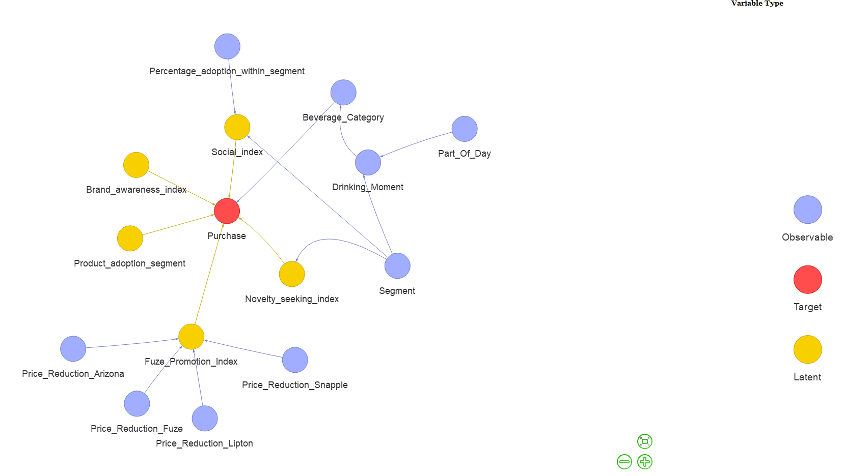
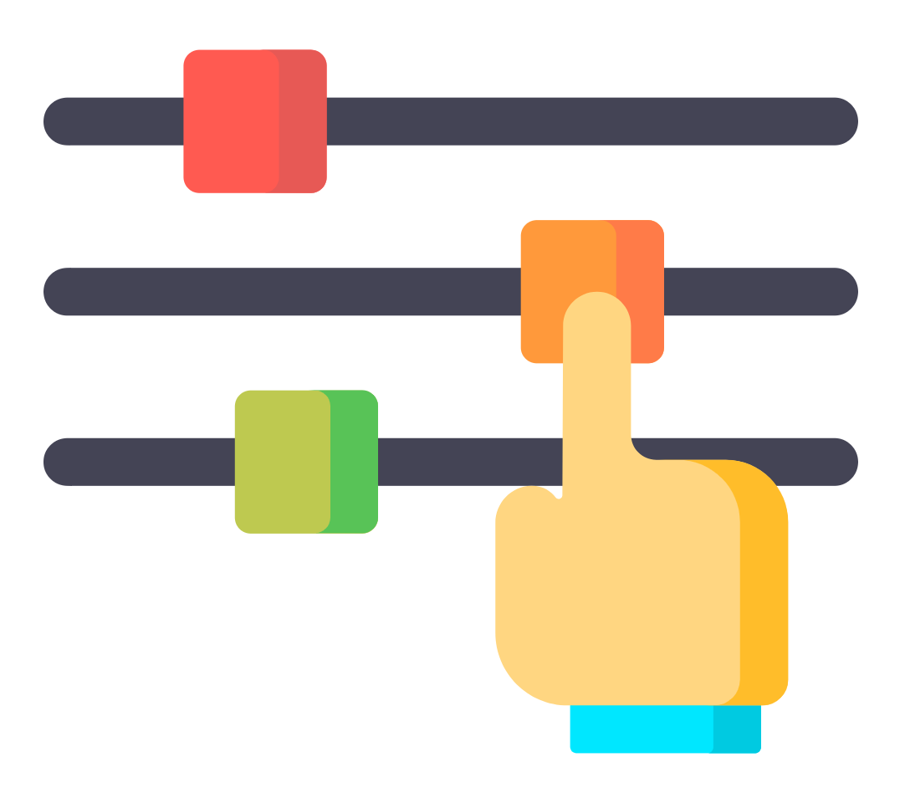

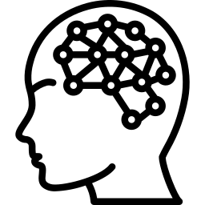




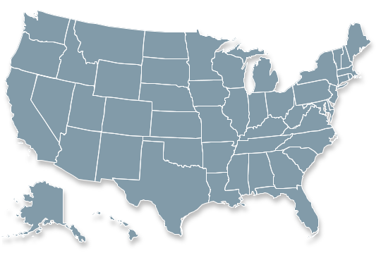




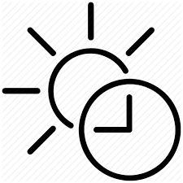
Proof of Concept Approach| Understand the purchase patterns of consumers from 2012 launch of Fuze Tea and leverage the learnings to provide prescriptive, pre-launch insights for a similar market/product
Agent Based Modeling – Simulation of the real world Interacting individual agents use their personalized properties and behaviors to simulate real world scenarios
Bayesian Network – Brain of the agent The graphical structure of the Bayesian network combined with the conditional probabilities forms the brain of an agent
What-if scenarios
Multiple what-if scenarios can be performed by tweaking the levers provided
Exogenous Environment
Endogenous Environment
Price reductions and promotions
Competitor price
Levers:
Product Price
Competitor Price
Promotions
Marketing Spends
Product Adoption stage
Agent
Novelty Index
Who is an agent?
- A US Household
- Belongs to a zipcode
- Belongs to a segment
Brand Awareness Index
Drinking Moment of an agent
Other agents
Temperature
Time of the day
Notes:
Speaker- Anoop

Slide 10
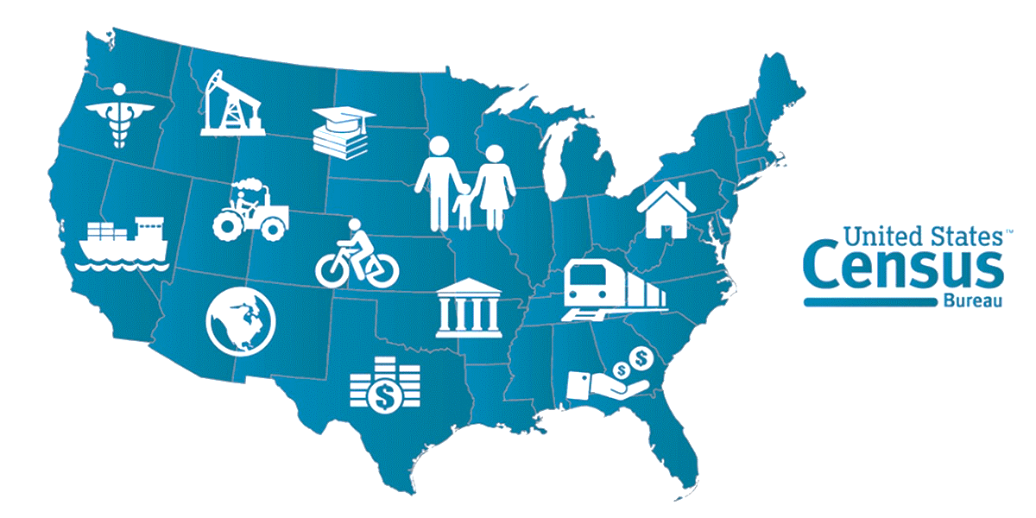


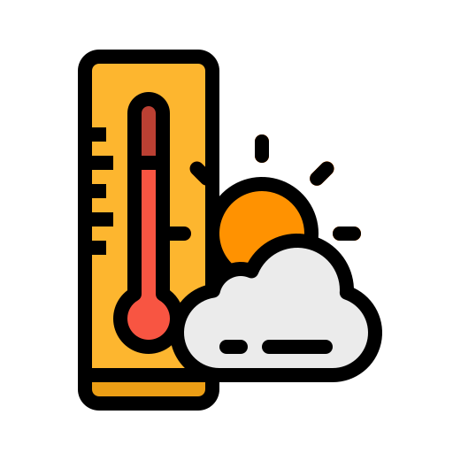




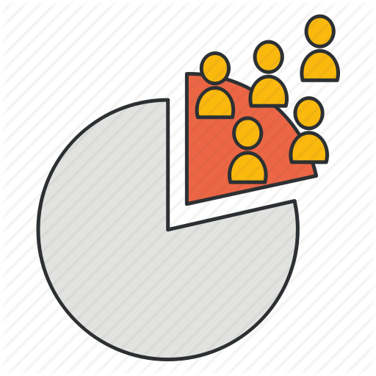
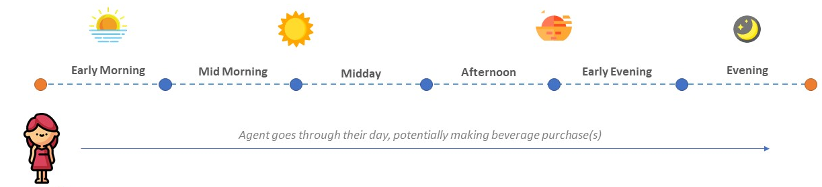




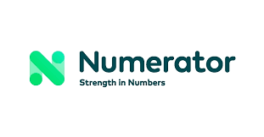
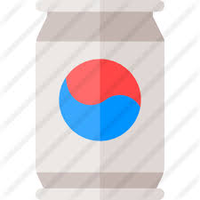

Customer’s Path to Purchase | Multiple factors affect a customer’s decision to purchase a product
Coke data on Drinking moment to Beverage Category
Heuristic rules on Segment and part of day to drinking moment
Publicly available temperature data
Nielsen Sales and pricing data
Loyalty Index
Leads to increase in Product Adoption Level…
Social Index
… leads to higher probability of next purchase
Brand Purchase
Brand Awareness
Feature Vision Feature and Execution data
Survey Data / Heuristics
Increases brand awareness
Reiterate on network parameters until model is validated at a macro level
Competitor pricing and promotion
Marketing spends
Data Sources

Slide 11
Encoding the Purchase Decision| The brain of the agent, which is its decision-making mechanism is represented, estimated, and implemented in the form of a Bayesian network
The network consists of 18 nodes connected with arcs describing a cause-effect relationship
The Red node is the final output – Purchase that is the result of the interconnections of all the nodes
Brand Awareness Index
Fuze Promotion
Product Adoption Index
Lipton Promotion
Novelty Seeking Index
Arizona Promotion
The Blue nodes at the corners have data available for them
The Blue nodes in middle of network gets data derived from other blue nodes
Based on the drinking moment & temperature, the agent picks a beverage category
Fuze Promotion Index
Snapple Promotion
Social Index
Purchase
Segment
Availability
Beverage Category
Data is synthetically created for yellow nodes/latent nodes
Some of the latent nodes are
Brand awareness index
Product adoption segment
Drinking Moment
Product Adoption in vicinity
Part of Day
Temperature
Weekday/Weekend

Slide 12







Stimuli| Consumers decision factors are impacted by a wide variety of internal and external factors
 |  | Drinking Moment | Drinking Category | Drinking Product
Consumer Factors | Brand Awareness Index
 | Loyalty Index
 | Social Influence
Controllable Factors | Promotions
 | Price
 | Marketing
 | New Product
Competition Factors | Competition Products
 | Competition Promotions
 | Competition Marketing
Environmental Factors | Weather

Slide 13

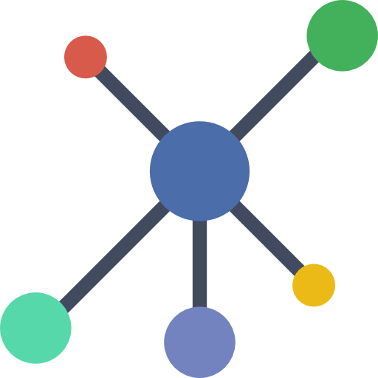
Bayesian Nodes| While some probabilities can be established through available data and pre-existing analysis, others require a more sophisticated method to create the nodes impact
Brand Awareness Index
Agent x
Data Sources
Incorporating into Bayesian Network
Initial Value (0-10)
Day n
Coke Survey Data (BGS)
3rd party survey data for media consumption (Nielsen/Kantar)
Outside Market Research(Personicx)
US Census Data
Heuristics
What channels do they interact with?
Bucket Value’s into
High, Medium, Low Bins
How much do they interact with each channel?
Day
n + 1
What channels did Coke marketing invest in?
Marketing Spends
MMx
Day
n
Yes
Which Channel?
Saturation
Effect
Did the agent see an ad?
Utilize parameter learning algorithms to quantify impact of Brand Awareness Index on final purchase
No
Decay Effect
Final Value

Slide 14
BAI Validation| Multiple approaches can be undertaken to validate the impact of brand awareness index
1
2
3
From Survey
From Website visits
From External models
BGS data can be used to understand levels of Brand awareness amongst different consumer segments
Calculate what % of hits on website is directed from Fuze tea (product of choice) along with demographic information of visitors
Understand the contribution of sales uplift caused by marketing in different channels through an MMX model
Ad reach of different channels can be validated from 3rd party data providers like Nielsen
Compare this with segment level brand awareness information obtained from simulation
Set marketing spends of individual channels to zero in the simulation and see if the sales decrease is similar
We need to iterate on various hyperparameters including Conditional probabilities, initial level of brand awareness and effect of ad exposure on various channels until we can validate the Index

Slide 15
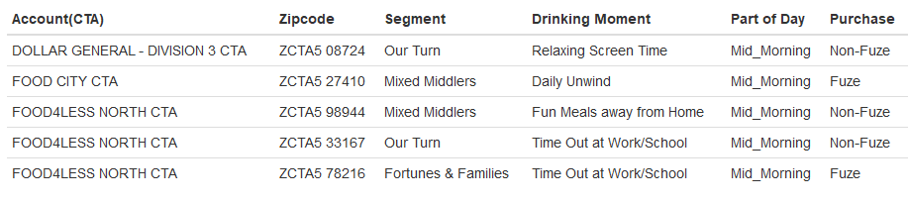
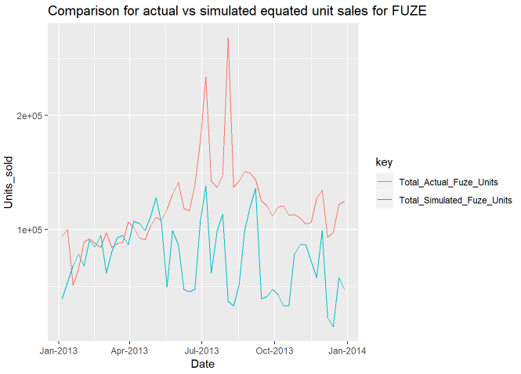
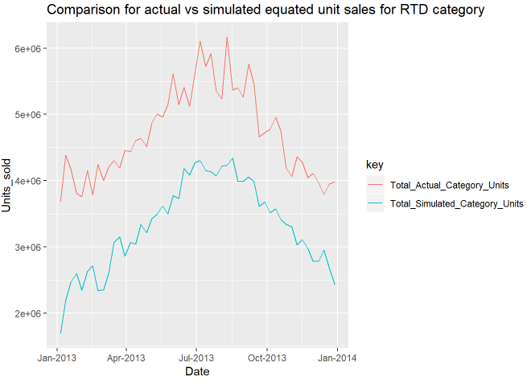
Model Validation | Model was able to create synthetic consumer level sales data; Overall sales accuracy 70%
Sample synthetic purchase data
Simulation results for 50,000 agents randomly sampled from the US for an year (Extrapolated for the entire population)
MAPE for Fuze predictions - 37.76%
MAPE for RTD category predictions - 29.87%

Slide 16

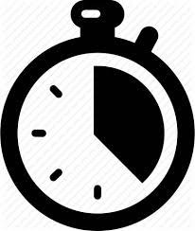
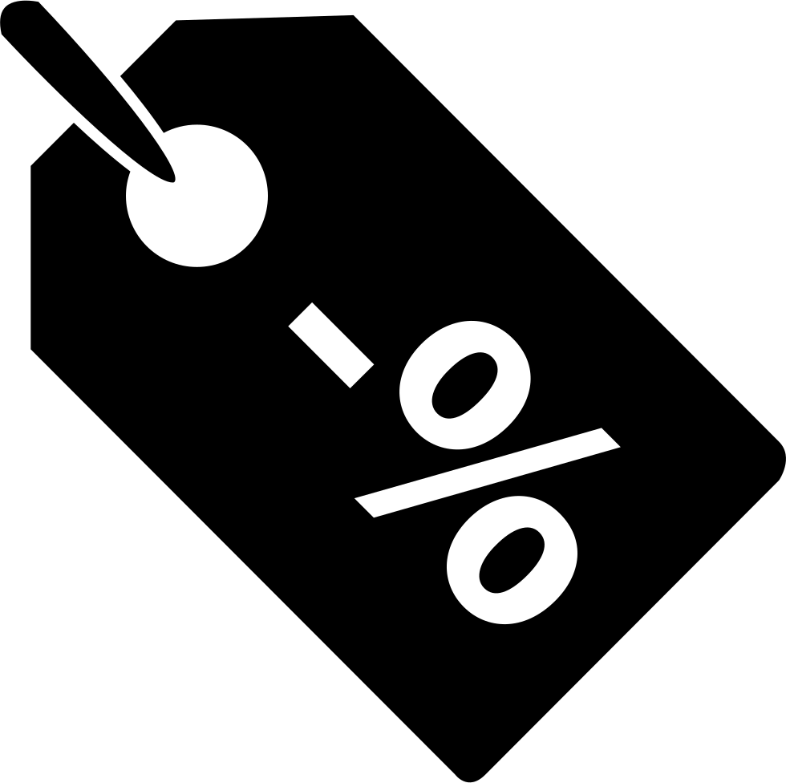
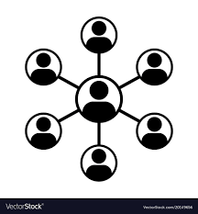

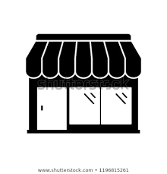


Sample Insights| Our model provides prescriptive insights into consumer behavior and the overall marketplace for a product launch
Synthetic Data generated from the network created for the US market provides the following insights about consumer & marketplace behavior:
What kind of consumers are most likely to consume Fuze Tea?
Fortunes & Families; Flush Families; Aging Upscale
Age group 36-65 years has highest penetration
Jumbo Families have high brand awareness
Which consumer segment will be the quickest to adopt Fuze tea?
Flush Families , Fortunes & Families
Which consumer segment will be the most sensitive to price/promotions?
High Discount: Beginnings, Transition Time
No Discount: Flying solo, Active Elders
Which segment of consumers are most likely to be social influencers?
Beginnings, Transition Time (rule based, may not be the true representation)
Micro-level
Insights
Marketing Team
Revenue Growth
Management Team
Sales Teams
Segments
What will be the purchase pattern of Fuze Tea?
Highest # of purchases happen during Midday & Afternoon
Key Occasions- Fun meals away from home; Time out at Work/School
How does weather impact the sales of Fuze Tea?
More sales in higher temperatures, 80% of total sales in temperature range 65-95 F
How will marketing levers effect the volume of Fuze Tea?
(simulation app demo)
Macro-level
Insights
Production Planners
Brand Strategy Team
*Note- The insights are based off of an experimental network and can be different from expected

Slide 17
THANK YOU!

Slide 18
APPENDIX

Slide 19
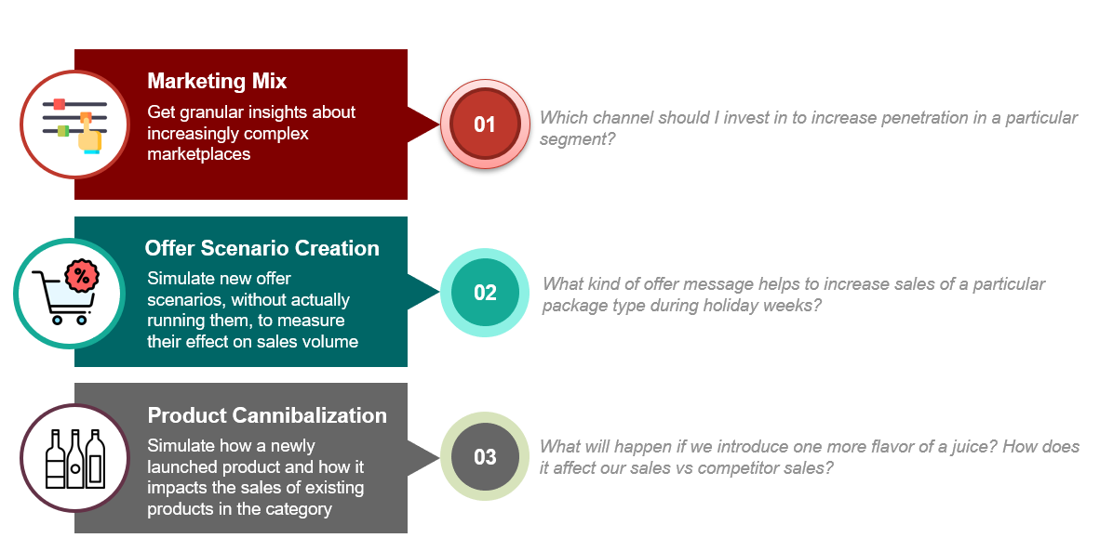
Broader Application of ABM
Marketing Use Cases | Agent based modeling along with simulation approach can play a vital role in facilitating predictive-prescriptive analytics across multiple problem areas
Notes:
Speaker- Dipti/Venki

Slide 20









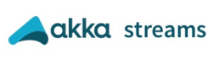

Scaling asks| ABM is built on an open source tech infrastructure that allows for easy scaling throughout the organization
Server Infrastructure: 20 core cluster | 25-30 Gigabytes RAM
Data Requirements
Sales and Pricing
Feature and Execution
Web Browser
Widget & Simulation APIs
Agent Simulation
Retailer location
Marketing and Trade Spends
Media Channel reach
Social media
Fetch Simulation metadata
Agent logs
Stream aggregated data to UI
Store simulation metadata
Consumer Survey
Temperature
Data aggregation and streaming
Economic Indicators

Slide 21

Proposed Timeline| Mu Sigma estimates 4 months to build and validate models with 50,000 agents
Deliverables
Deliverables | Phase | Activities | Weekly breakup
 |  |  | 0 | 1 | 2 | 3 | 4 | 5 | 6 | 7 | 8 | 9 | 10 | 11 | 12 | 13 | 14 | 15 | 16
 | Phase 1 Model Building Phase for MVP within R | Pre-kickoff activities – paper work and registration
Data Dictionary |  | Build data dictionaries and solution approach
ADF and EDA Report |  | Knowledge Transfer, ADF creation and EDA to understand features
Bayesian Network Development |  | Finalize Network structure and estimate parameters
Testing and Validation |  | Validate on macro data and iterate on parameters
Integration |  | Simple R Shiny Dashboard for clients to check output before scaling
Milestone 1
Milestone 2
Architecture diagram | Phase 2 Web tool For Scale | Final architecture plan
UI Development |  | Develop UI for the Web tool
Deployment |  | Development, setting cadence and rules
 |  | Integration and testing in prod environment
TO BE DECIDED
ADS – Analytical Data set
EDA – Exploratory Data Analysis
*Phase 1 starts post data procurement
Mu Sigma Confidential

Slide 22
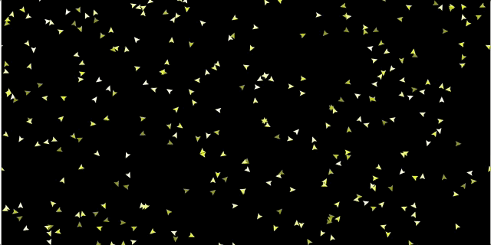
COMPLEXITY | Agent Based Modeling is an unique approach to understand and model the complexity within today’s marketplace
An agent based model simulates the actions and interactions of autonomous agents which allows for a view on their effects on the system as a whole. Particularly effective in cases where it is difficult to capture complex interactions in the form of equations
The birds follow three rules:
Alignment, Separation, and Cohesion
"Alignment" means that a bird tends to turn so that it is moving in the same direction that nearby birds are moving.
"Separation" means that a bird will turn to avoid another bird which gets too close.
"Cohesion" means that a bird will move towards other nearby birds (unless another bird is too close).
Notes:
The proposed solution is to understand the market dynamics using a bottom up approach with consumer at its center.
What ABM as a technique does is enables us to create individual consumers as entities in a virtual world and then create a network of all the factors which impact his decision making.
These factors could be from his profile or the market forces like we talked about earlier.
We then leverage Bayesian networks to model the interactions of all these factors. The combined impact of all these factors is then quantified for each consumer by fusing all the available data to us. All data sources are integrated and enhanced whether it is national survey of consumer preferences , CTA level Nielsen data ; store level feature vision data or publicly available census data… The Bayesian network allows creation of business intuition based heuristic rules and probability assumptions which breaks down data till the consumer level.
We then fine tune and validate these heuristic rules and probability assumptions by modeling past behavior of all agents and comparing the aggregated results with the past actuals data.
Once we have a set of rules and assumptions which in aggregate is comparable with the past we can say that we have better understanding of consumers.

Slide 23
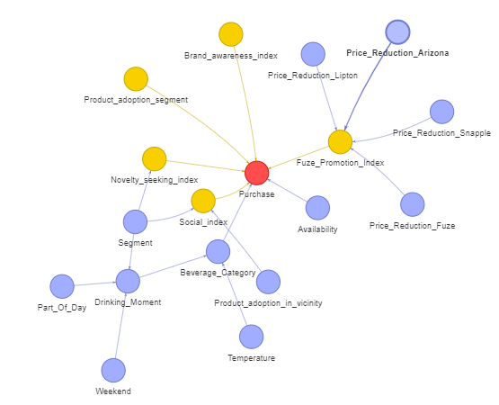
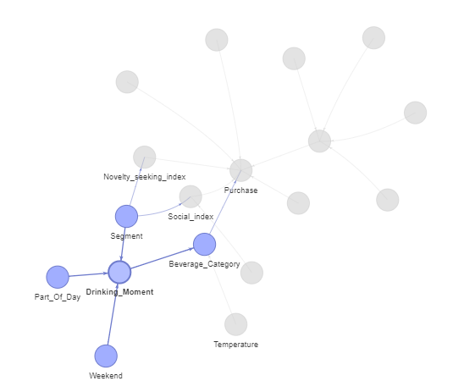
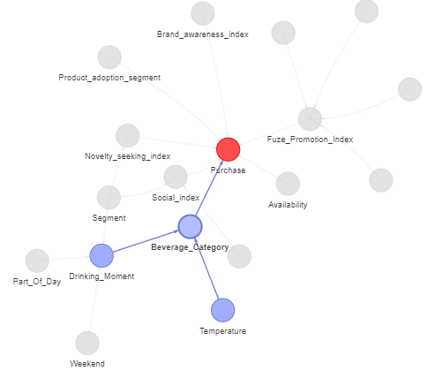
CONSUMER’S PATH TO PURCHASE| ABM mimics consumer purchase decision flow thereby creating bottom up data for analysis
Depending on the segment of an agent, time of the day and weekend/weekday, agent gets assigned a drinking moment
Based on the drinking moment & temperature, the agent picks a beverage category
Impact of all other factors, decide if the agent purchases coke products if he choses RTD
Notes:
Speaker- Anoop

Slide 24
NETWORK INPUT| A number of data sources along with heuristics were fused to create conditional probability tables for the Bayesian Network nodes
Node | Source
Synthetic demographic segment data | US Census and PersonicX segmentation data
Drinking Moment, Beverage Category | Slides from CBL 2.0 in S&I Connect Portal
Purchase, Price reduction across brands | Nielsen sales data
Promotion and Display metrics | Feature Vision data
Temperature | Publicly available temperature data
Overall marketing spends | Slide from Coke intranet
Novelty Seeking, Brand Awareness, Social Index, Product Adoption Segment, Fuze Promotion Index | Rules based on business knowledge and assumptions
Assumptions
Customers from a state are proportionately distributed to CTAs based on volume share of RTD Tea sales Marketing reach of each channel is proportional to Recall metric of marketing spends slide Effect of promotion/display is same for all CTAs and segments
Heuristic Rules
Agent drinking moment behavior defined based on segments and part of day Agents have a higher probability for choosing a drinking moment on a hot day Agents have different motivations to purchase Fuze based on how often they have consumed in the recent past - product adoption segments Agents who do not consume Fuze often are motivated by combinations of social index, brand awareness and promotions Agents who consume Fuze often are primarily motivated by the availability of flavors, promotions, etc.

Slide 25


Creating Brand Awareness Index |
Brand Awareness Index captures the current level of brand perception by an agent, dynamically updating itself every time an agent is exposed to an advertising piece
1
2
3
Understand Media Exposure
Calculate Brand Awareness
Validate impact on Purchase
Calculate macro level sales lift caused by marketing
Define Brand Awareness Index
Understand overall media consumption
Calculate ad exposure frequency
Tune parameter till sales lift is validated
Layer in Segment level information
Update brand awareness index
Back

Slide 26
Understanding Media Exposure |
Use Nielsen Data to identify reach of media channels to different segments
In case segment level data is not available -
Use overall numbers of media reach for e.g. – Average number of hours spent by Americans on TV/Digital media (link)
Layer in heuristic knowledge to approximate segment level media consumption
E.g.- 1. Younger people on average use more Internet (Agent’s age negatively correlated with digital minutes)
2. Digital minutes are positively correlated with probability to see a digital ad
3rd party data providers like Nielsen (link) provide data on reach of different media channels to different demographic segments. Use this data to calculate % of people in different segments who are exposed to these media channels. BGS Survey data can be used to understand reach of other marketing mediums like coupons, billboards etc.
Back

Slide 27
Calculating Brand Awareness Index |
Calculate ad exposure frequency
Generate spend vs reach curve of different channels from Marketing Mix models to understand how reach increases with spends (non-linear). Calculate the level of reach for different levels of spends on different channels
Segregate Brand Awareness into bins
Define a brand awareness metric
The Brand Awareness index is then segregated into multiple buckets and incorporated into the Bayesian Network of every agent
Update Brand Awareness
Define a brand awareness metric ranging from 0 – 10. It is initialized using survey data to understand current level of brand awareness for different segments
Based on relative channel effectiveness channel reach and ad exposure frequency, Brand Awareness Index is updated on a daily basis for every agent (details in appendix)
Learn Bayesian Network Parameters
The conditional probabilities associated with Brand Awareness -> Purchase is then learned using Parameter learning algorithms
Decay/Adstock Effect
Brand Awareness continuously goes down with time according to a logged model unless agent is exposed to newer ads (details in appendix)
Back

Slide 28
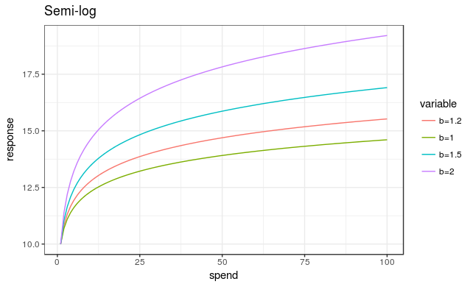
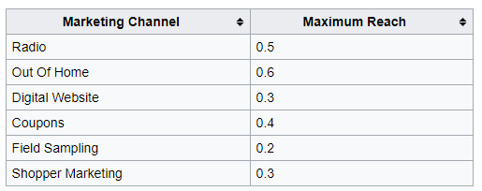
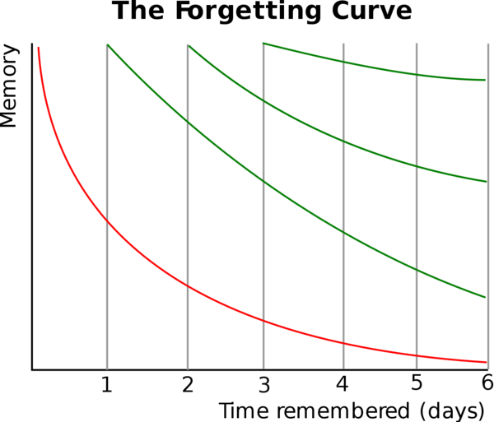
Brand Awareness
Example of a spend vs reach(response) curve:
Channel Reach:
Decay Effect
Week's Reach Percentage for a Marketing Channel = (Adjusted Weekly Spend / (Base Weekly Spend * 3) ) * Maximum Reach
Memory is volatile, it depletes over time. So, the agents exposed to marketing campaign about FUZE, remember the product for some time, and the probability of them recalling the brand depletes over time.
Forgetting curve describes the decline in the probability of recall over time
R = exp(-t/S)
where:
R - probability of recall (retrievability of memory)
S - strength of a memory trace (stability of memory)
t - time
Relative Channel Effectiveness:
Channel Touchpoint:
In POC: Channel Recall Values from a Coke Deck has been used as proxy for effectiveness
Ideally: Use beta values from a MMX model to understand effectiveness and scale them appropriately to the scale of Brand Awareness Index
If channel reach % is 0.8, then 80% people are marked as Channel Touchpoint = Yes (1), rest 20% are marked as No (0)
Increase in Brand Awareness:
Every time a person is exposed to an ad his Brand Awareness increases by
= ChannelTouchpoint (1/0) * Channel Effectiveness
Back

Slide 29
PersonicX Consumer Segments
Customer Segment | Description
Our Turn | Age - 36-65 | Upper Middle - Middle Income group | Rural, Suburbs & Downtown Metro
Mixed Middlers | Age - 35-65 | Single | Middle - Low Middle Income group | Rural, Downtown Metro
Fortunes & Families | Age - 36-65 | Married | Upper Middle - Middle Income group | Rural, Suburbs & Downtown Metro
Leisure Buffs | Age - 66+ | Low Income group
Flush Families | Age - 36-55 | Affluent | City and Surrounds
Taking Hold | Age - 18 - 35 | Middle- Upper Middle Income group | Towns and Suburbs
Active Elders | Age - 66+ | Upper Middle Income group | City and Surrounds
Golden Years | Age - 46+ | Affluent - Upper Middle Income group| Suburbs and Towns
Cash & Careers | Age - 30-45 |Wealthy - Affluent| Suburbs and Towns
Modest Means | Age - 46- 65 | Low - Low Middle Income group| Suburbs, Towns and Downtown Metro
Mature Wealth | Age - 46 - 65 | Wealthy | City and Surrounds
Aging Upscale | Age - 46 - 65 | Affluent - Upper Middle Income group
Transition Time | Age - 30 - 45 | Middle - Low Middle Income group| Rural, City and Surrounds
Family Focused | Age - 30-45 | Middle, Low Income group| City and Surrounds
Mixed Singles | Age - 36 - 65 | Middle, Low- Middle Income group| Rural, Downtown Metro
Mature Rustics | Age 46 + | Low- Middle Income group | Rural
Middling Singles | Age - 36-45 | Middle- Low Middle Income group | Downtown metro, City and Surrounds
Jumbo Families | Age - 30-45 | Married | Affluent, Upper Middle Income group
Flying Solo | Age - 24 - 35 | Single | Low, Low-Middle Income group| City and Surrounds
True Blues | Age - 36 - 55 | Married | Low Middle Income group
Beginnings | Age - 18 - 29 | Low, Low-Middle Income group | City and Surrounds
Back

